Slide 1
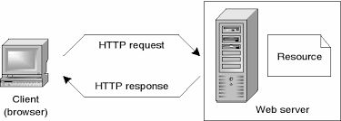
How Does the Internet Work?

Slide 2
What do you need to be a web developer?
Qualifications do you need to become a web developer?
You should also ideally have an aptitude for - or experience of - elements such as:
User experience (UX)
User interface (UI)
Visual design
Coding languages including HTML and CSS
Frontend web programing languages and skills such as JavaScript, Ajax and web animation techniques
Backend web programing languages such as C# or Java, PHP and Ruby
Design software like Photoshop and Illustrator and Sketch
An understanding of SEO
Web servers and how they function

Slide 3


Slide 4
Why did you choose to learn web development?
Best career opportunity
Why Web Development
It’s much simpler to do and learn
Creative & Expanding field
Attractive salary package with high growth

